Slide 1
BIA at USC

Slide 2
Mission Statements
BIA at USC is a student organization that founded with a goal to create a vibrants international students community and serve as a bridge between International students and American Cultures.

Slide 3
Meet the Team

Slide 4
Team Structures：
President
VP of Operation
VP of Business Development
VP of Marketing
VP of Art & Creativity
General Secretary
Treasury
Directors
BIA Community Members

Slide 5
Founding Members and Eboard
President
Bob Yang
USC 27’
B.S. Environmental Studies and Behavioral Economics
VP of Operation
Jerry Wang
USC 27’
B.S. Business Administration and Behavioral Economics
VP of Business Development
Xinpeng Long
USC 27’
B.S. computer Sciences
VP of Art & Creativity
Ana Cheng
USC 27’
B.S. Marketing
VP of Marketing
Regina Bian
USC 28’
MS in Marketing

Slide 6
Founding Members and Eboard
VP of Art & Creativity
Angela Hsieh
USC 28’
B.F.A Film and TV Production
VP of Business Development
Dorra F
USC 26’
MBA

Slide 7
Founding Background For BIA at USC

Slide 8
Experiences as an International Student Now
Chinese Student and Scholar Association (CSSA) and Chinese American Student Association (CASA)
Advantage and disadvantage of CSSA
Advantages: Backed by Chinese embassies, have a rich history in USC, numerous professional connections that creates job opportunities for USC students
Disadvantages: lacks diverse social events, lack of supports for new USC students, lacks of efficients(198 positions in club)
Advantage and Disadvantage of CASA
Advantages: Fun Social Events, numorse social activities, fun General Meetings, new student supports.
Disadvantages: Target mostly American Born Chinese, minimal professional development, limited freshman student help.

Slide 9
Challenge Faced

Slide 10
What is BIA at USC
BIA at USC is an student organization that is founded in March of 2024 with a vision to provide cultural events and create social scenarios for international students.
BIA at USC hopes through designing, marketing, and promoting different social events within USC to help student who participate inside some pre-professional practices
BIA at USC

Slide 11

Who is BIA：
南加大BIA 是一个在南加州大学（USC）于2024年3月份成立的一个拥有全新理念的学联。南加大BIA的使命是为USC所有学子创造共同的福利与享受。我们为所有入学的学生提供种种不同的免费服务与校园信息。目前来说我们的目标群体是来自中国的处于不同学习阶段的留学生与当地华人群体。
我们运行着一个完全开放且免费的会员资格系格。通过此会员资格系统，学生们可以完全免费参加我们所带来的，学校周边的，不同免费折扣（洽谈中），以及我们定期在学校里举办的社交活动，包括并不局限于（免费电影，艺术，文化相关活动以及娱乐活动。)

Slide 12

BIA理念：
100%免费为学生提供活动
与USC周边商家进行商业洽谈，为USC学生提供便利折扣
发起全校范围的活动，并尽经济范围可行的能力去实现在校同学的梦想
解决新生的疑问
创立新生群为所有新生提供及时，准确的的帮助
撰写科普文章并在微信公众号上发表，帮助新生们快速的掌握学校核心信息
提供社交机会
拥有专属于学校的IP创造，打通学联与学生之间的隔阂并产生一定的文化上的共鸣，并增强学生之间的归属感

Slide 13
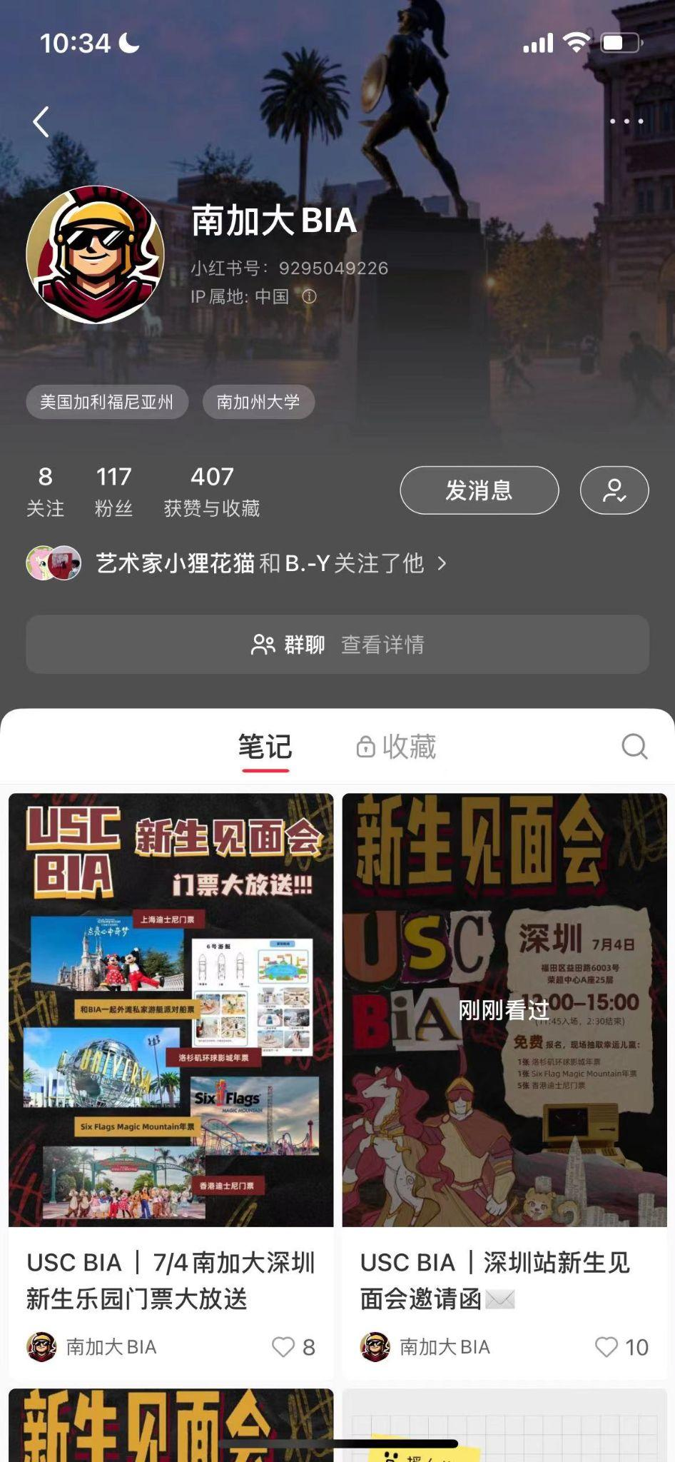
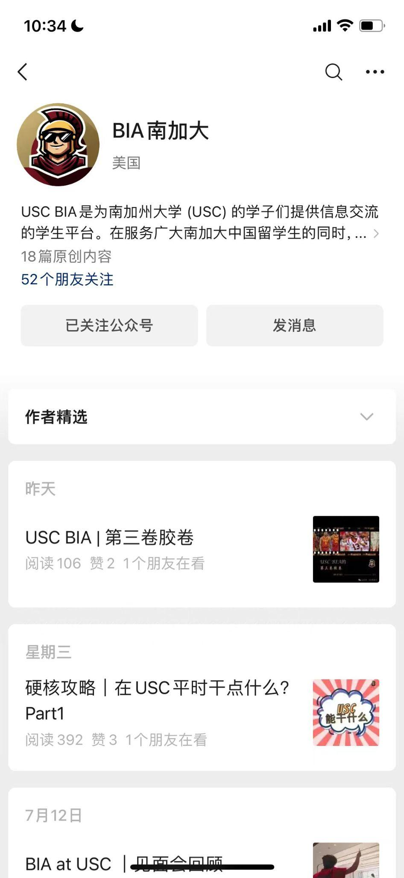
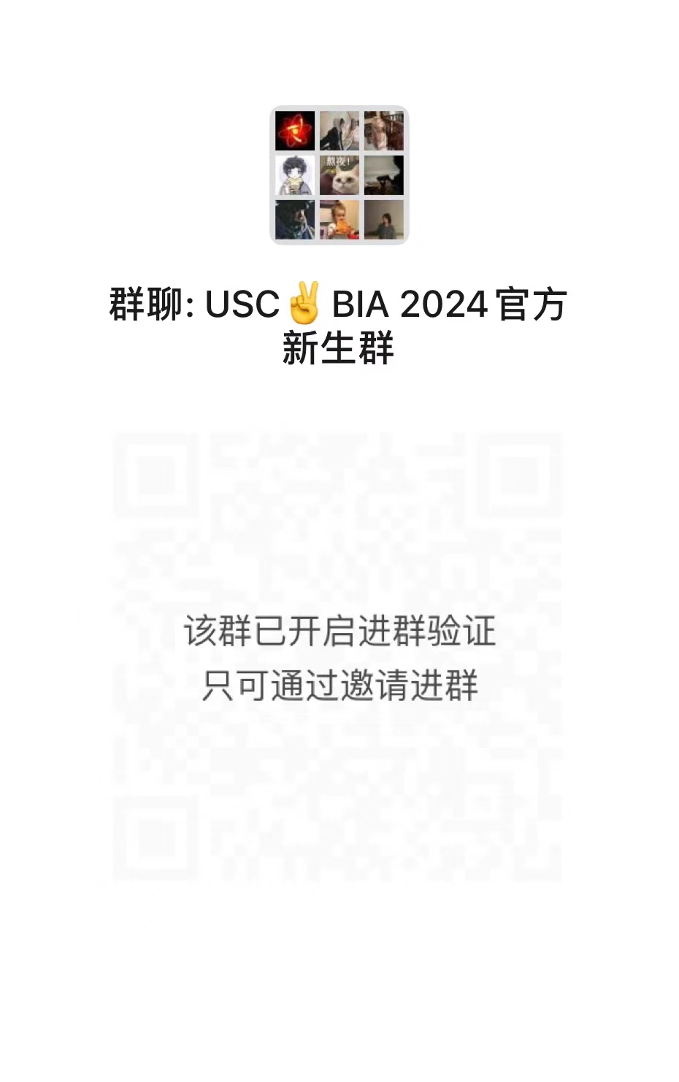
BIA现有社媒平台介绍：
公众号
学生群
小红书

Slide 14
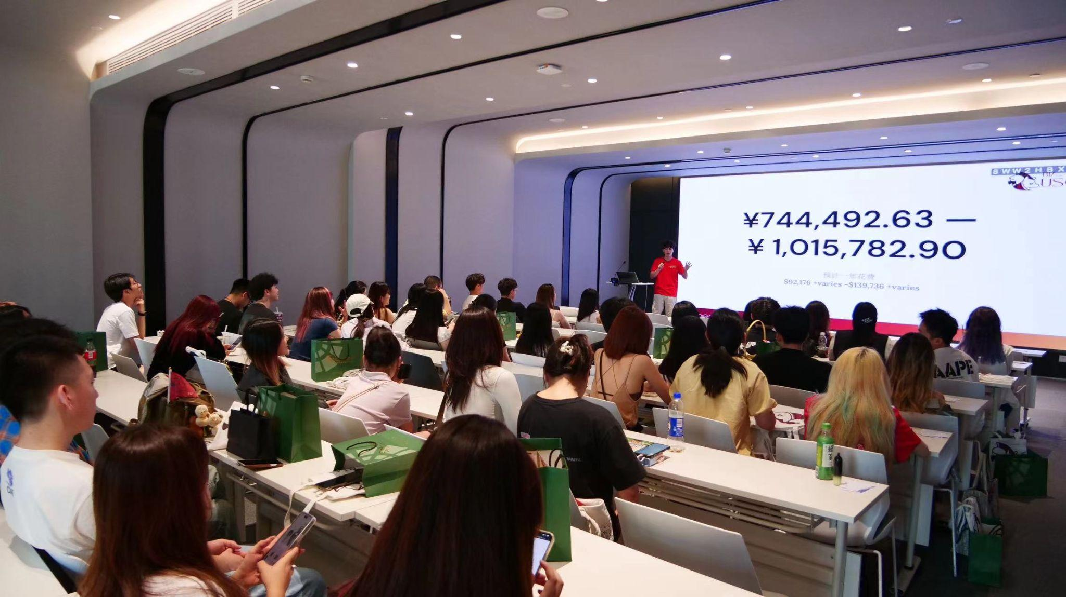
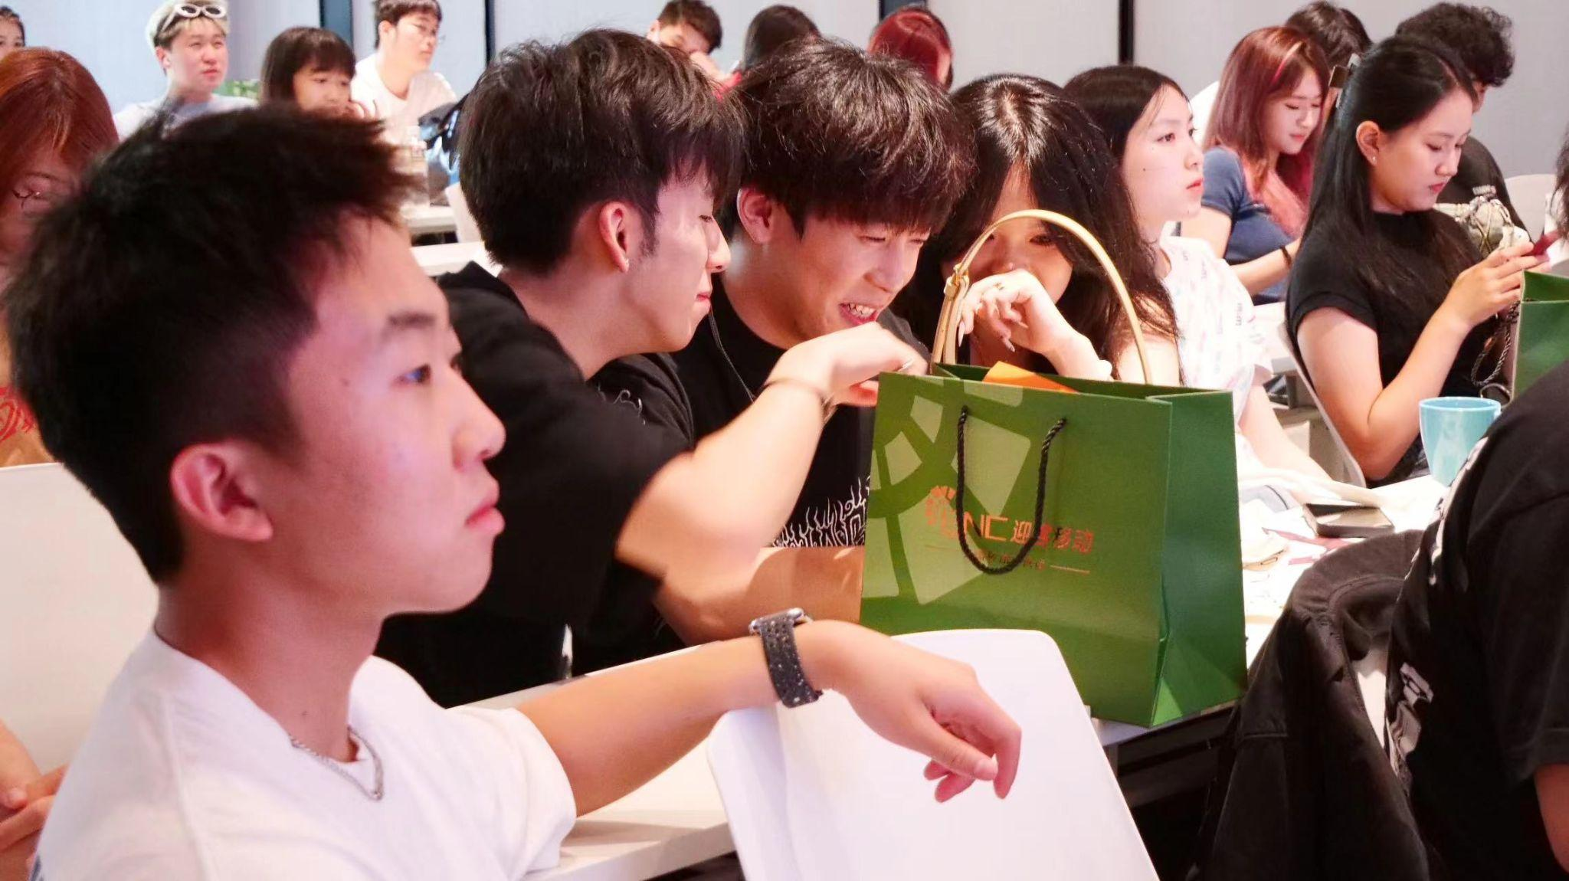
BIA现有业务介绍：
现有活动：
社团成员周边美食打折活动
开学季迎新会
即将开展：
万圣节派对
spring /Fall Formal invites
社交小程序
春晚
（每次major event都将办活动）

Slide 15




我们的优势 — 巨大潜力
我们目前有合作的赞助商：
(More to come…)

Slide 16
赞助package介绍：
等级 | 价格 | 包含服务(皆包含优先活动赞助权及赞助优惠)
单独品类独家赞助 | $7,000 | 免费参与一切BIA主办活动 3篇头条（次条可谈）/小红书 学生群推广
金赞助 | $4,000 | 50% discount 2篇头条(次条可谈)(小红书可谈) 学生群推广
银赞助 | $3,000 | 25% discount 1篇头条(次条可谈)(小红书可谈） 学生群推广
铜赞助 | $2,000 | 10% discount 1篇次条(头条discount) (小红书可谈） 学生群推广
专属活动 |  | 可自行寻找合作商家共同承担开销

Slide 17
关于优先活动赞助权及赞助优惠的解释：
凡与BIA签订一年份赞助合同的商家都可以根据自己的等级获得对应的优先活动赞助权及赞助优惠，适用于BIA主办的所有活动。
注*：同类型商家不可存在同一赞助等级，赞助等级基于先来先选，等级更高的商家在BIA活动举办时有优先赞助权，且同类型商家一场活动仅限一家。BIA拥有最终解释权！

Slide 18
联系方式及汇款方式：
BIA President：yby040202
VP of BD：FZZ_mi
汇款方式：zelle/paypal/venmo/Bank wire Transfer
注：所有账目公正公开

